Slide 1
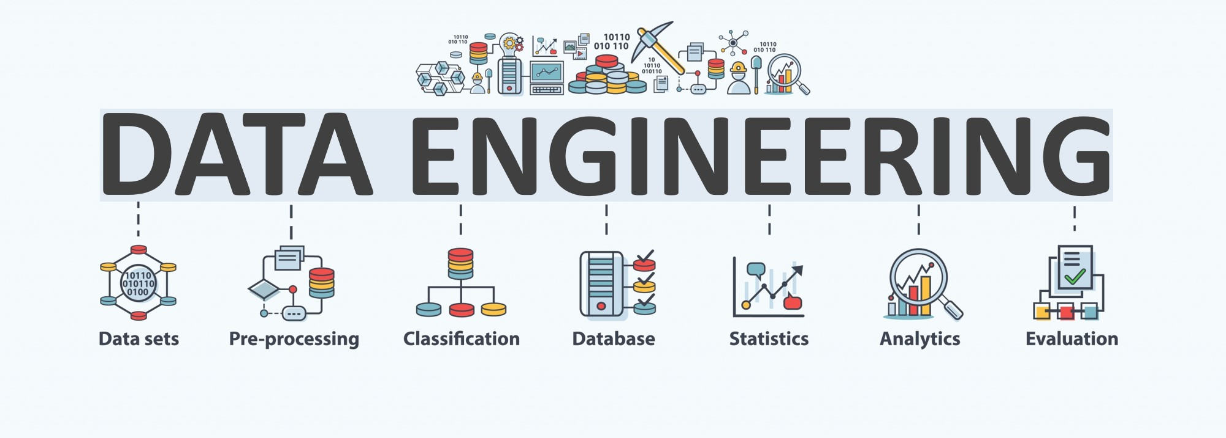

Lecture 10: Advanced Topics and Recent Trends
CS5481 Data Engineering
Instructor: Yifan Zhang

Slide 2
Outline
Representation learning and multimodal learning
Data bias issues
Explainability

Slide 3
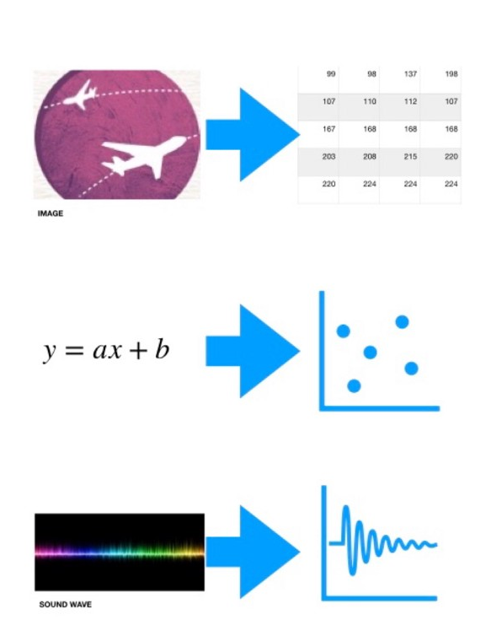
What is representation learning?
Representation learning: a set of techniques that allows a system to automatically discover the representations needed for feature detection, clustering, or classification, etc. from raw data.
Representations are features in embedding (or latent, representation) space.
The very hot technique, deep learning, is a non-linear method to learn representations of images, texts, etc.

Slide 4
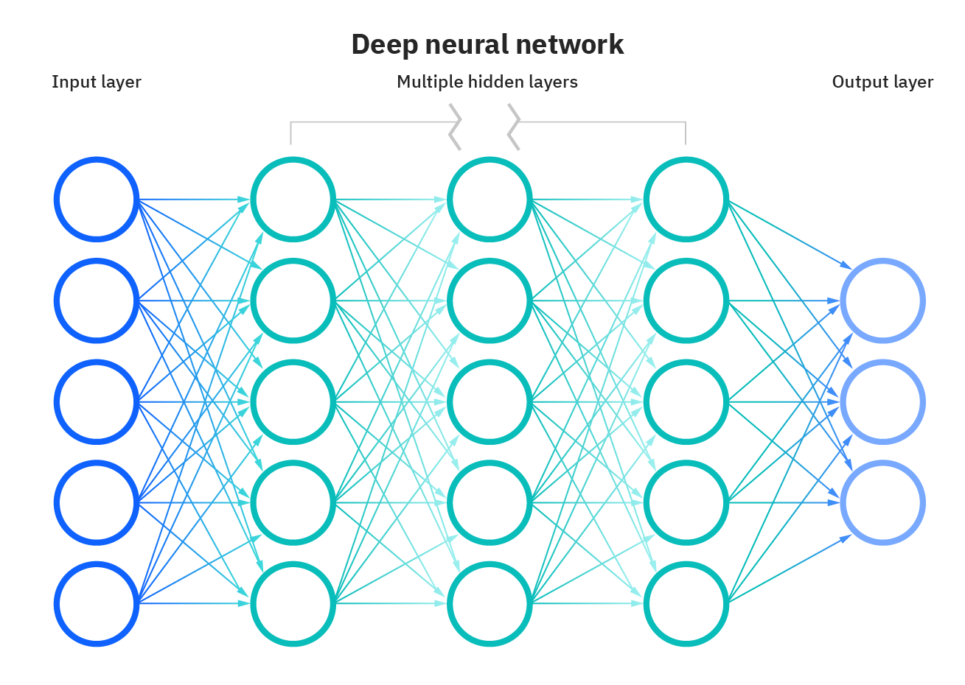
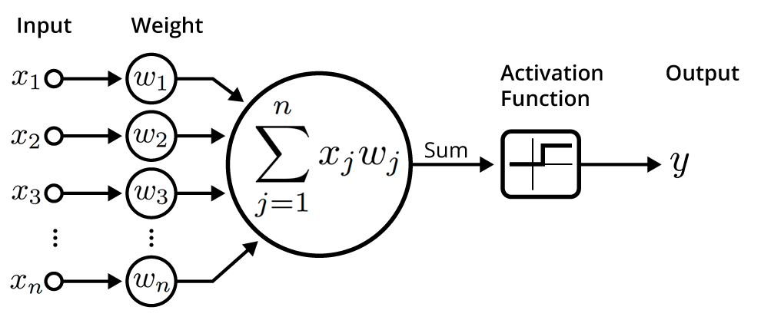
Deep learning for representation learning (1)
Deep Learning is a subfield of machine learning concerned with algorithms inspired by the structure and function of the brain called artificial neural networks, usually with more layers.
Neurons are computing nodes.
Lines connecting neurons representing weights
Usually used for image processing, automatic
speech recognition, text processing, and many
other tasks.

Slide 5
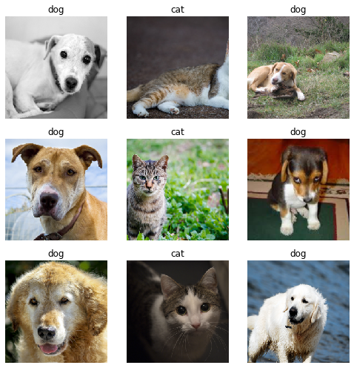
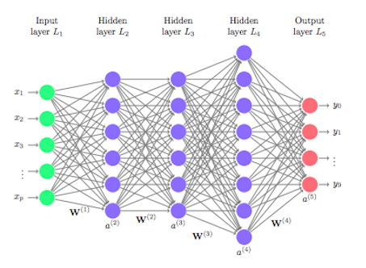
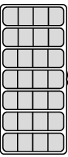
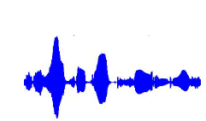
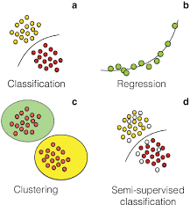
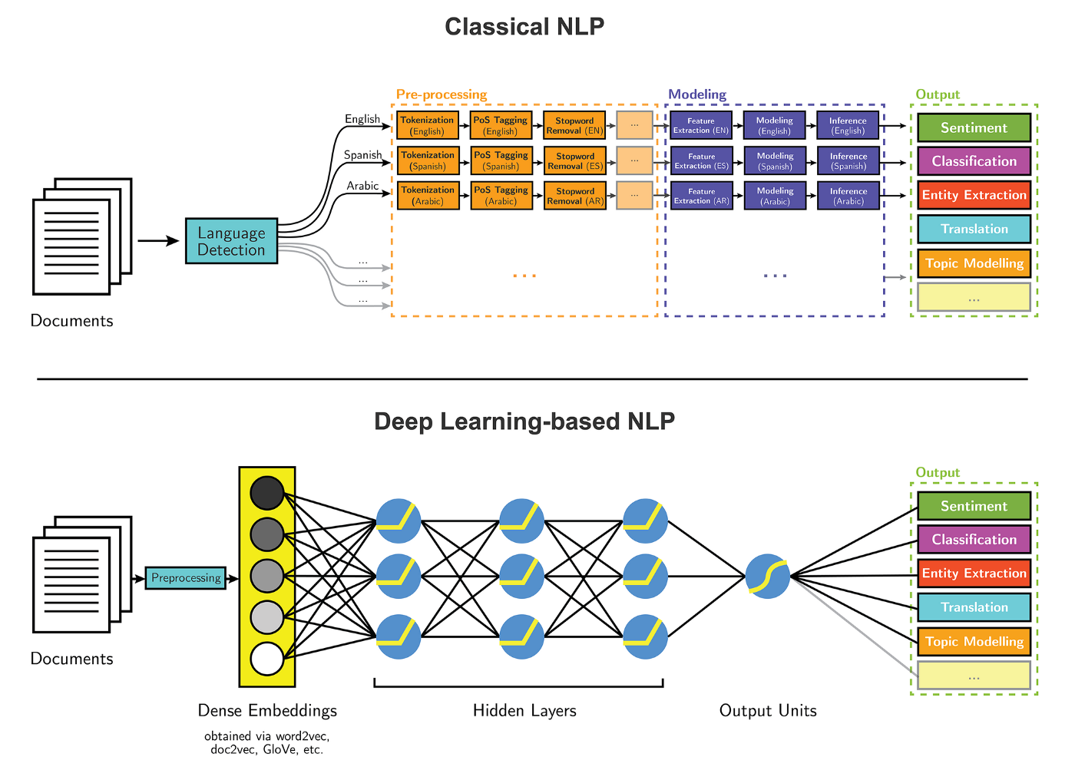
Deep learning for representation learning (2)
Deep learning maps images, texts, speeches, etc. into vectors in representation spaces. If downstream tasks are trained together, then it is end-to-end.
Image pixels
Speech signal waves
Text tokens (words)
Representations
(latent vectors)
Downstream tasks

Slide 6
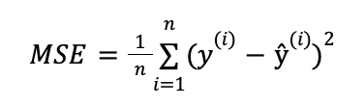
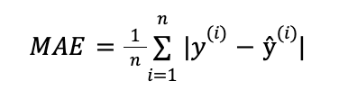
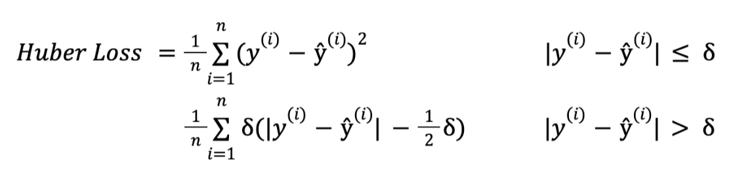
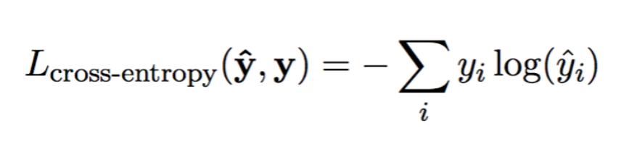
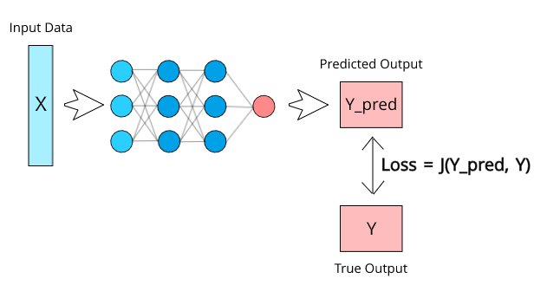
Deep learning for representation learning (3)
Loss function is important to guide the training of neural networks.
Commonly used loss functions: Mean Squared Error (MSE), Mean Absolute Error (MAE), Huber Loss, Cross-Entropy Loss
Training: stochastic gradient
descent based method

Slide 7
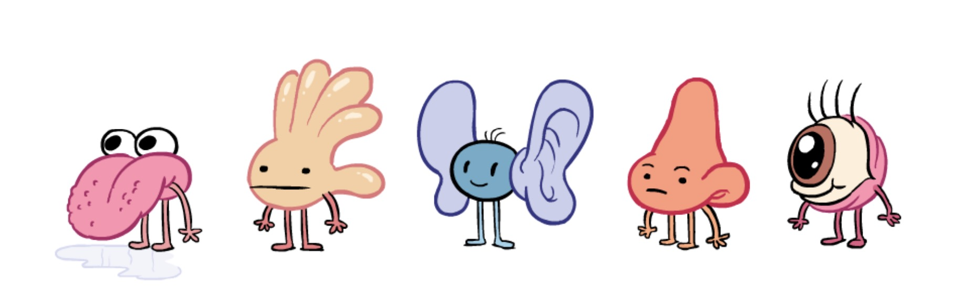
Why do we need multimodal learning?
“Our experience of the world is multimodal - we see objects, hear sounds, feel texture, smell odors, and taste flavors.”
“In order for Artificial Intelligence to make progress in understanding the world around us, it needs to be able to interpret such multimodal signals together.
Multimodal machine learning aims to build models that can process and relate information from multiple modalities.”

Slide 8
What is modality?
The way in which something happens or is experienced.
Modality refers to a certain type of information and/or the representation format in which information is stored.
Sensory modality: one of the primary forms of sensation, as vision or touch; channel of communication.

Slide 9
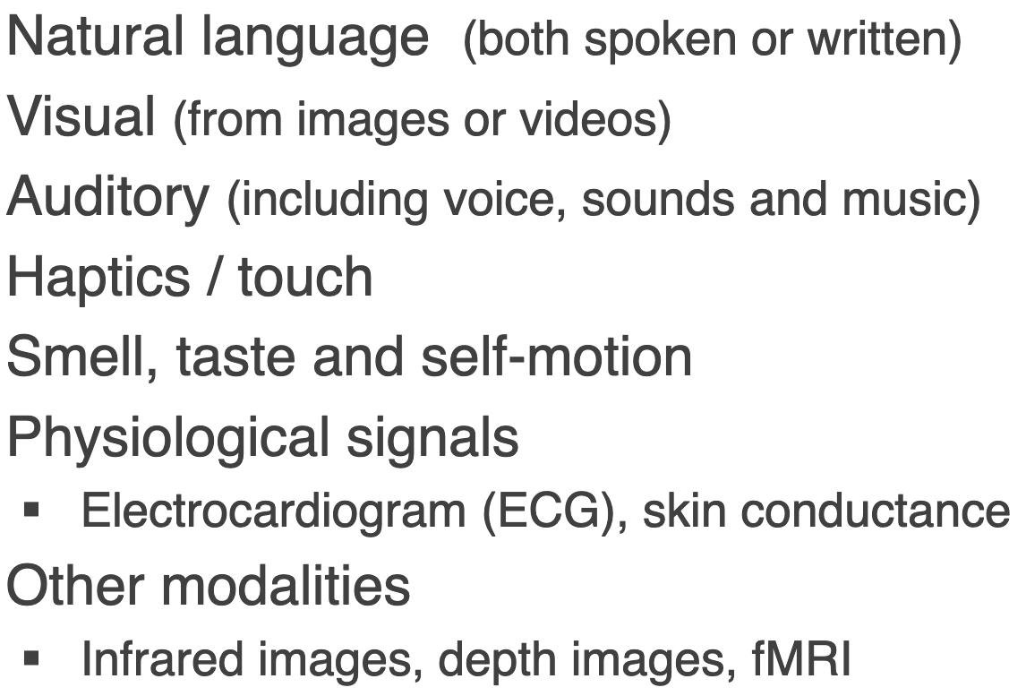
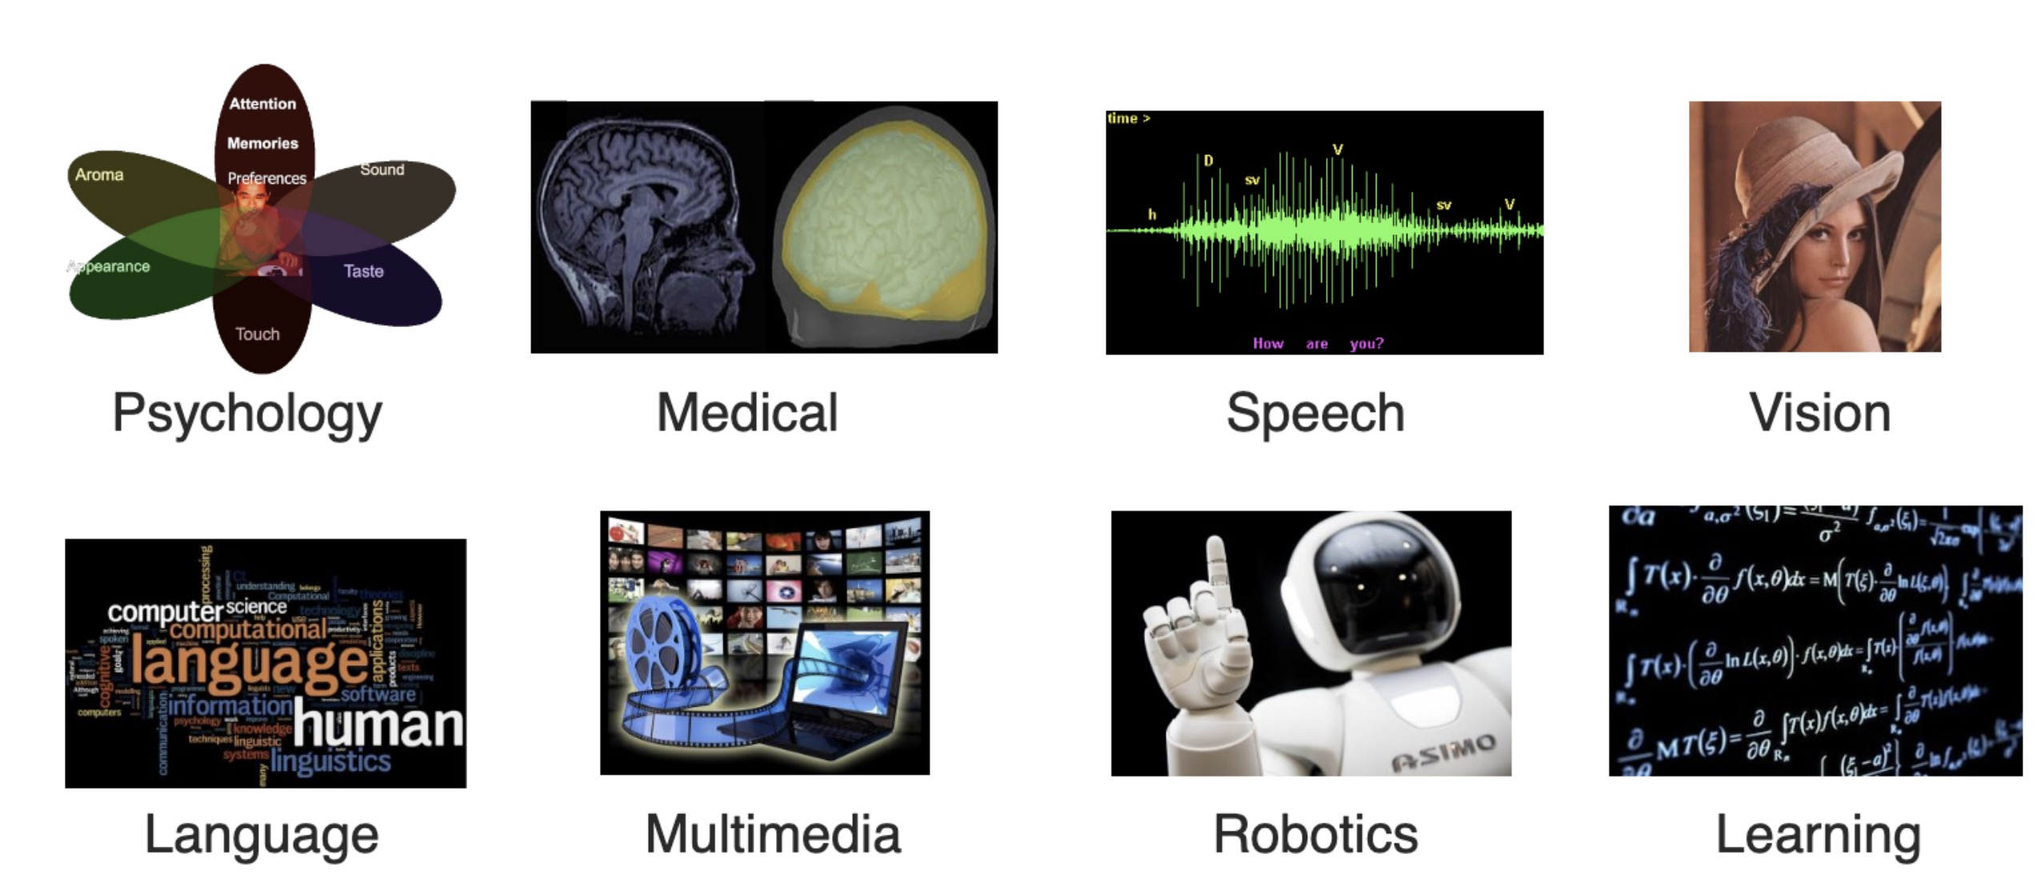
Multiple modalities
There are multiple types of modalities.

Slide 10
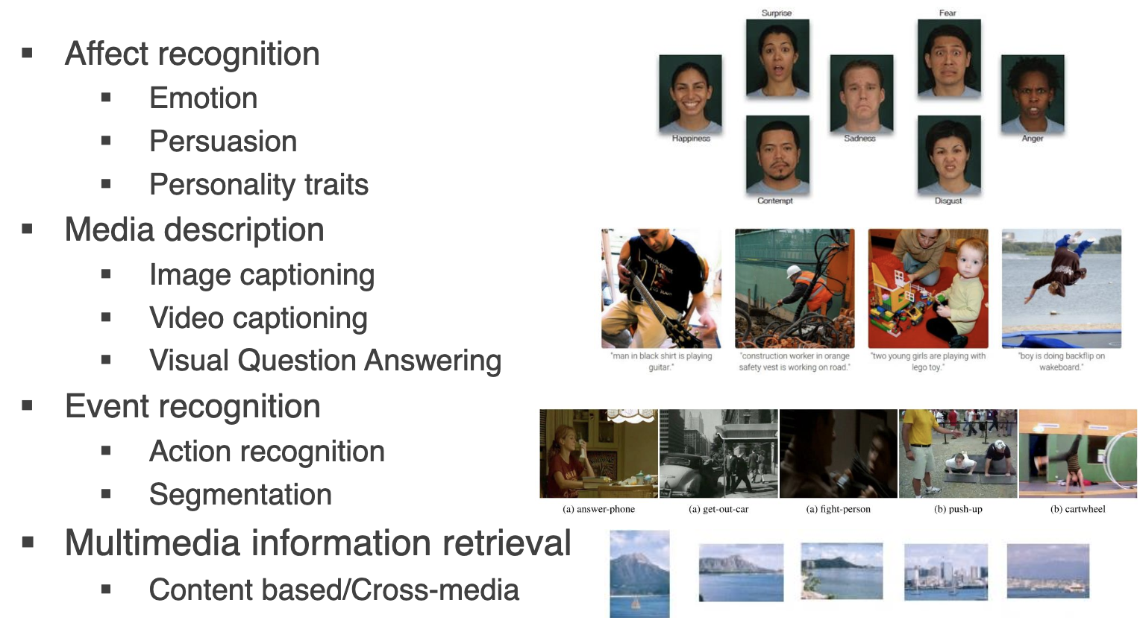
Real-world examples

Slide 11
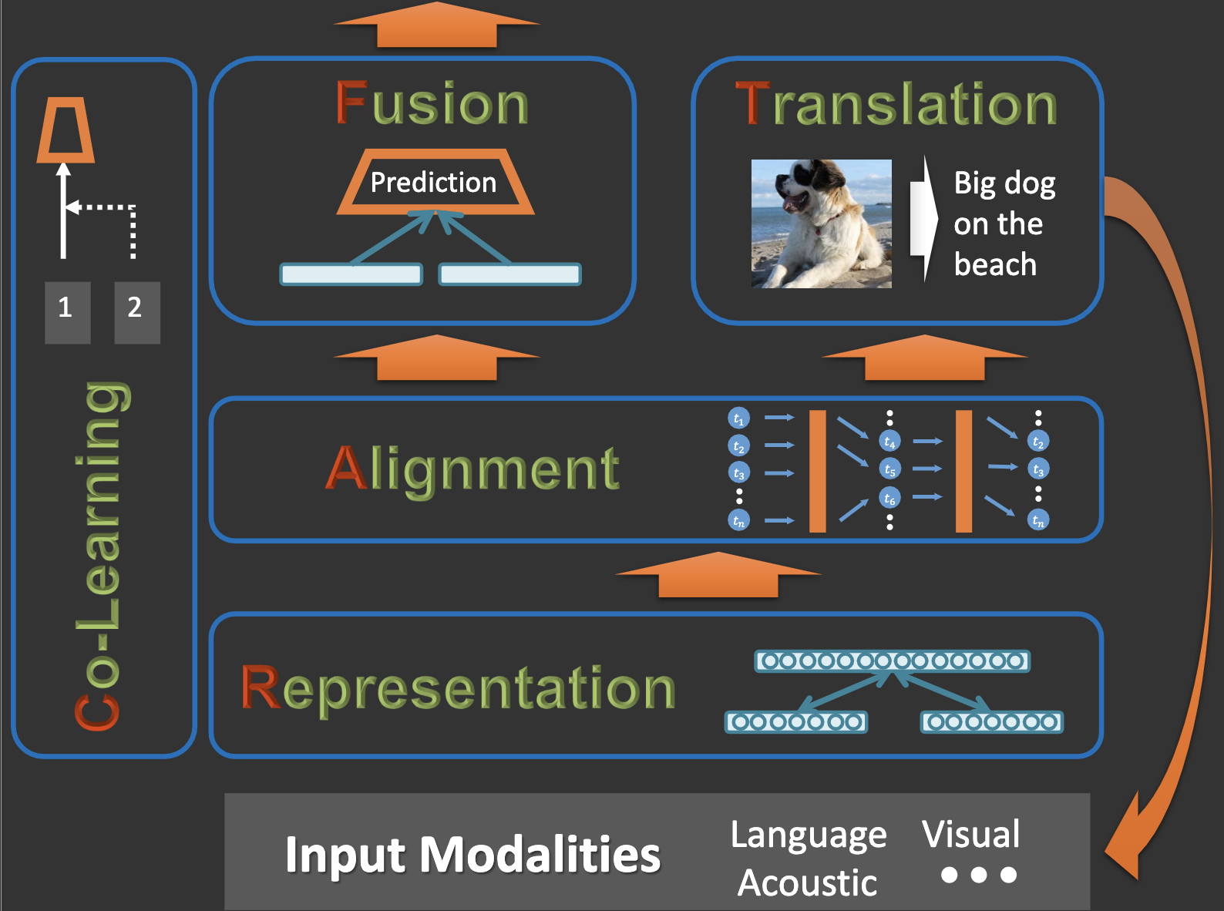
Core technical parts
Representation
Alignment
Fusion
Translation
Co-learning

Slide 12
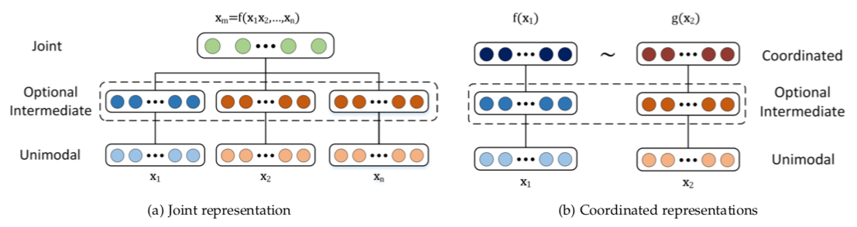
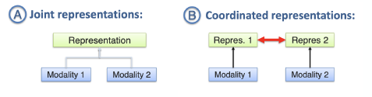
Multimodal representation
Learning how to represent and summarize multimodal data in a way that exploits the complementarity and redundancy.

Slide 13
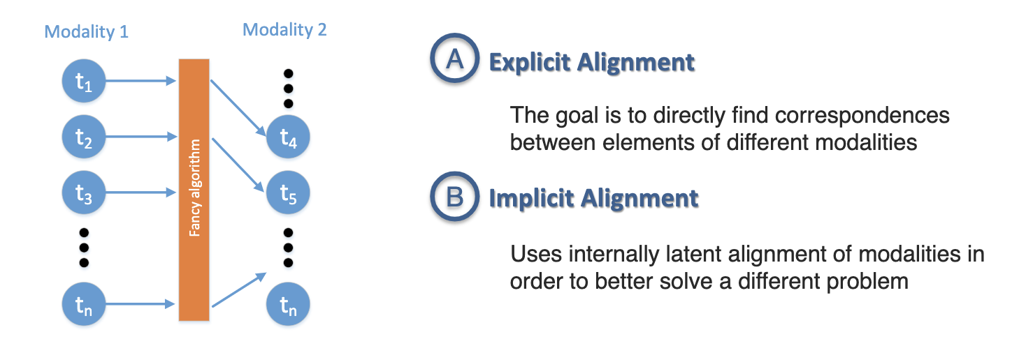
Multimodal alignment
Identify the direct relations between sub-elements from two or more different modalities

Slide 14
Multimodal alignment
Identify the direct relations between sub-elements from two or more different modalities

Slide 15
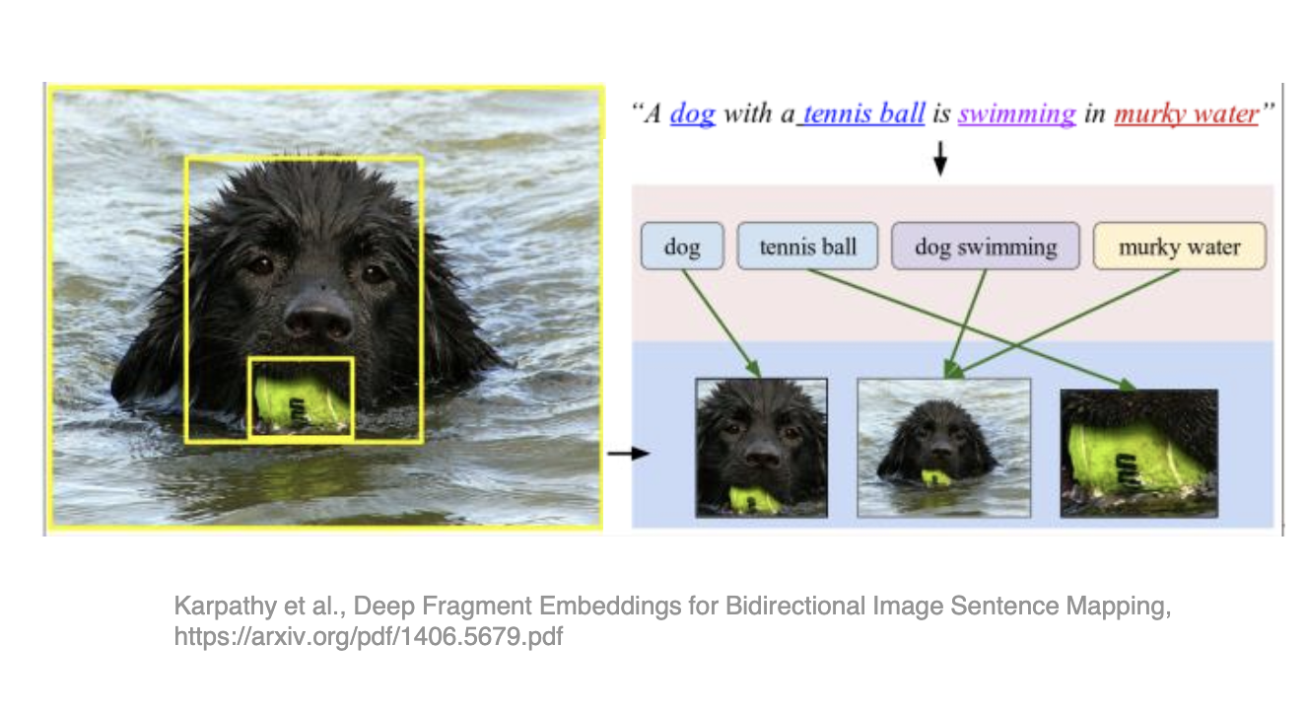
Multimodal alignment example

Slide 16
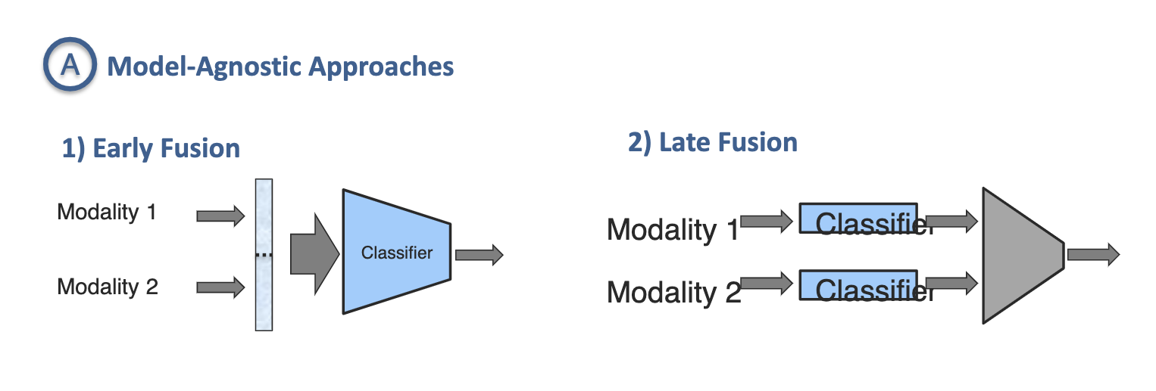
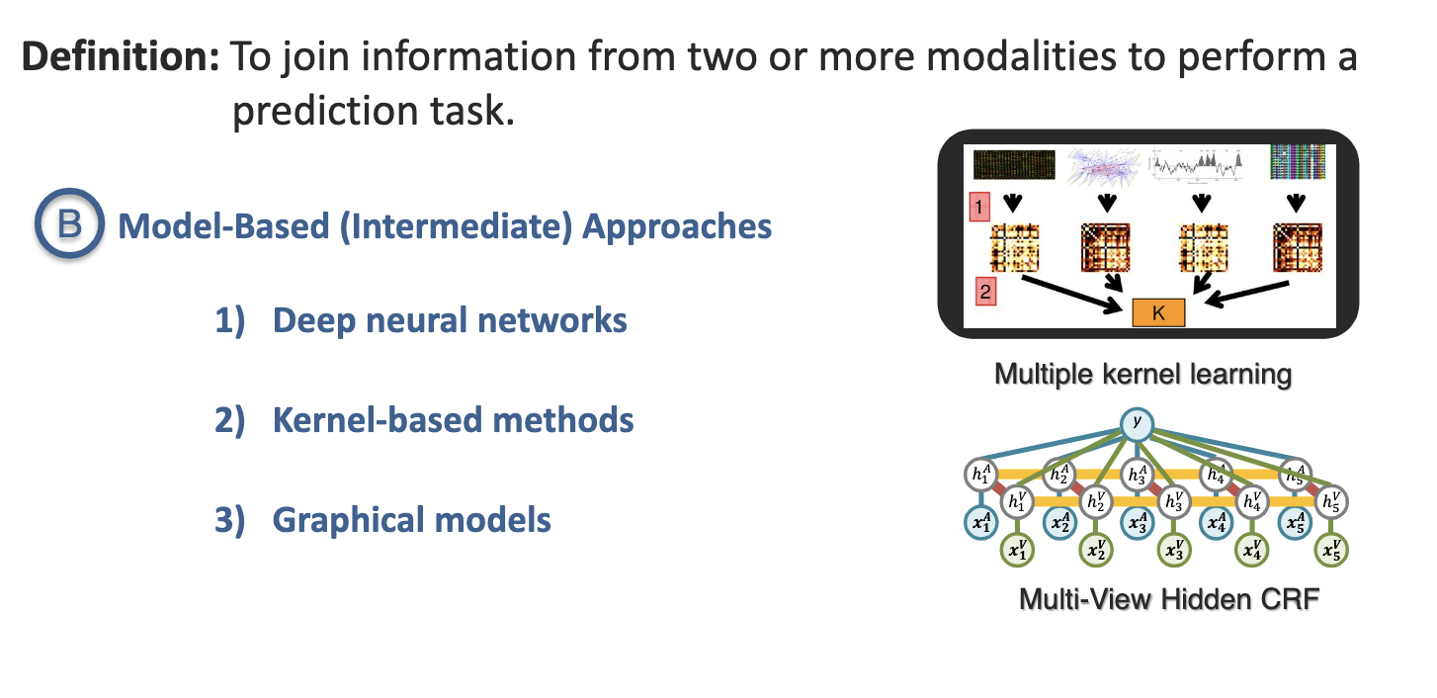
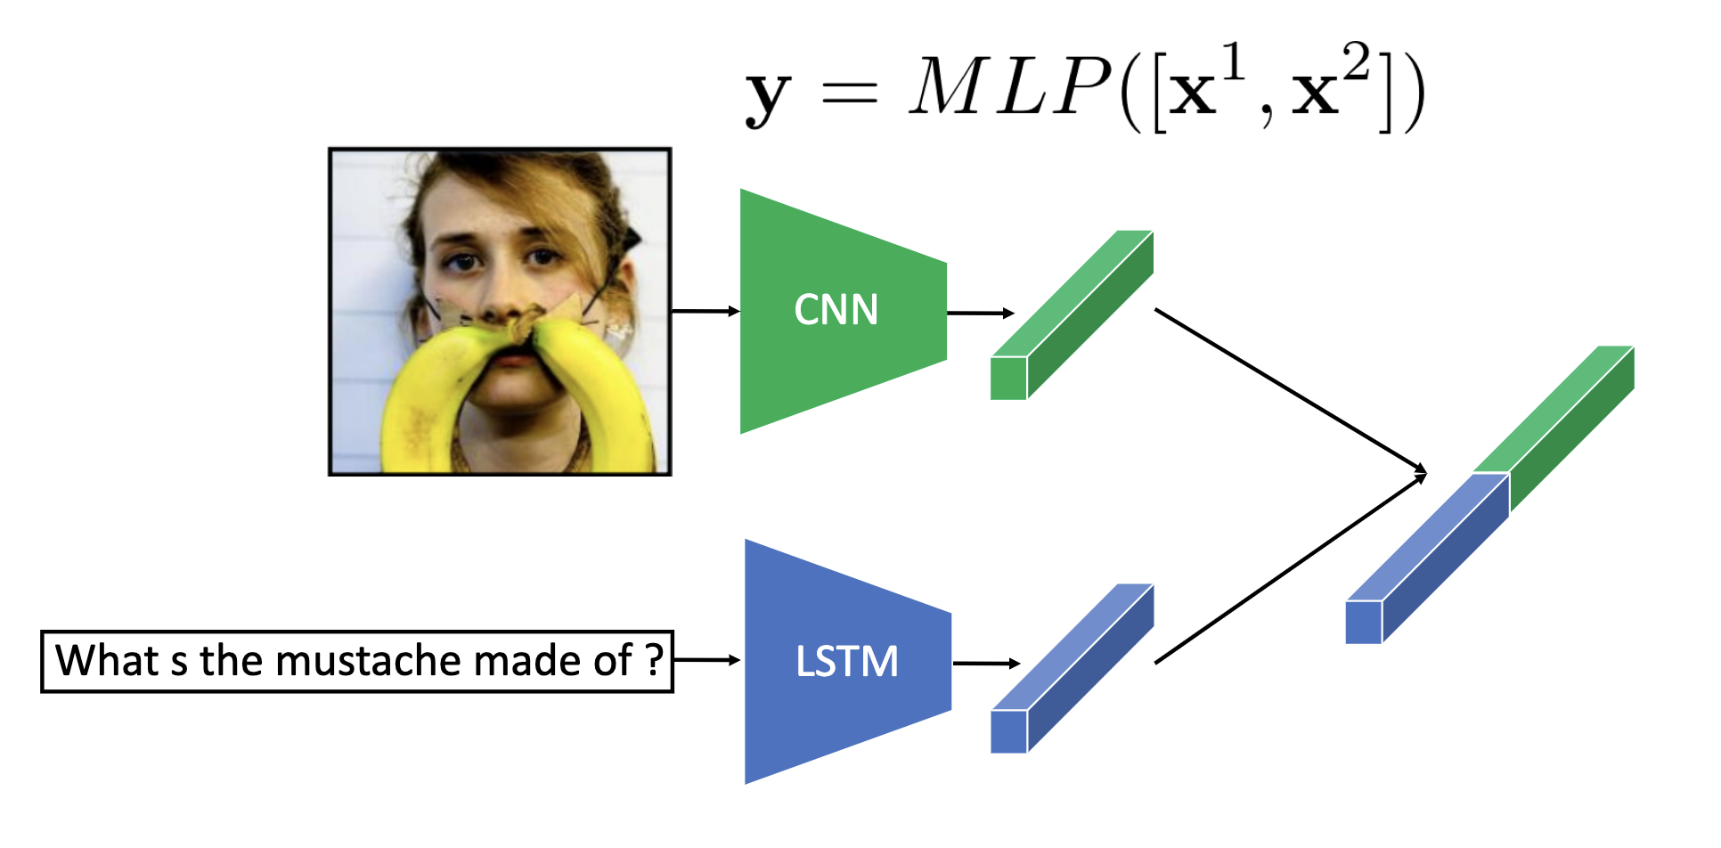
Multimodal fusion
To join information from two or more modalities to perform a task, e.g., prediction, classification.

Slide 17
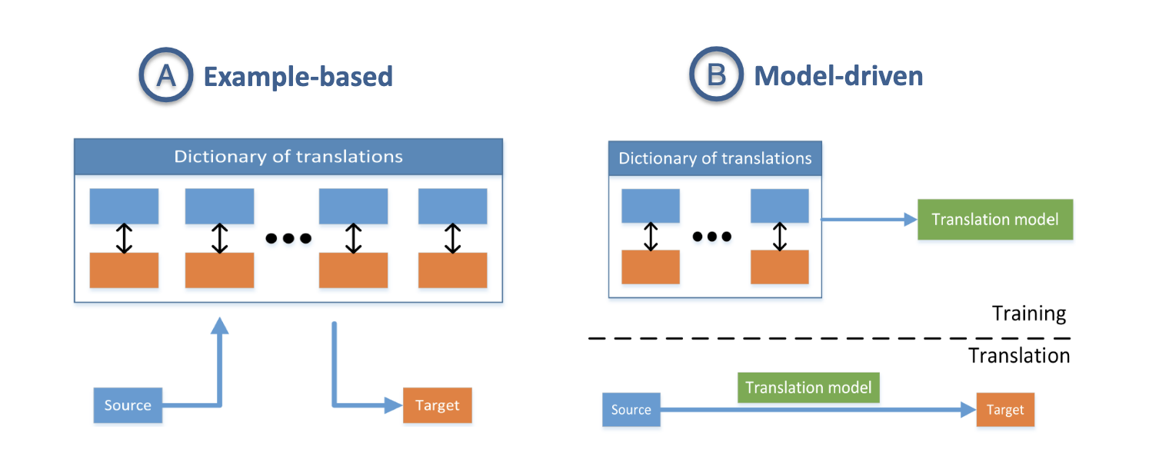
Multimodal translation
Process of changing data from one modality to another, where the translation relationship can often be open-ended or subjective.

Slide 18
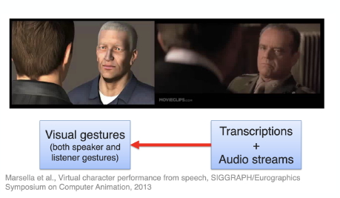
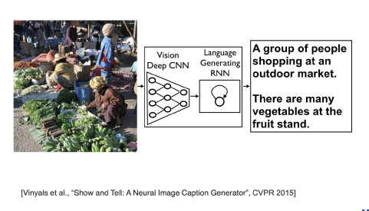
Multimodal translation example (1)
Translating transcriptions and audio streams to visual gestures
Translating images to texts (captions)

Slide 19
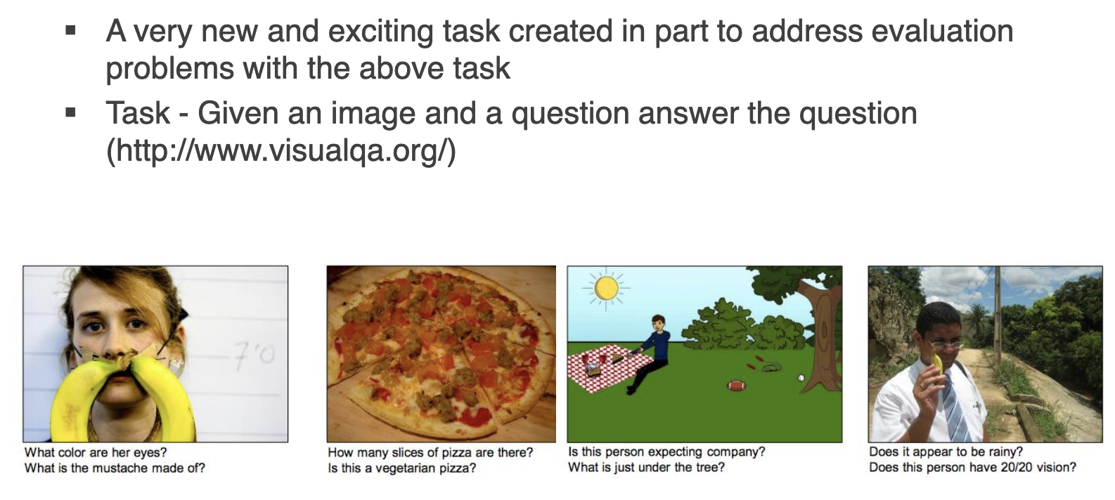
Multimodal translation example (2)
Visual Question Answering

Slide 20
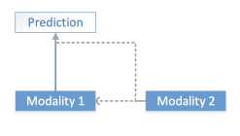
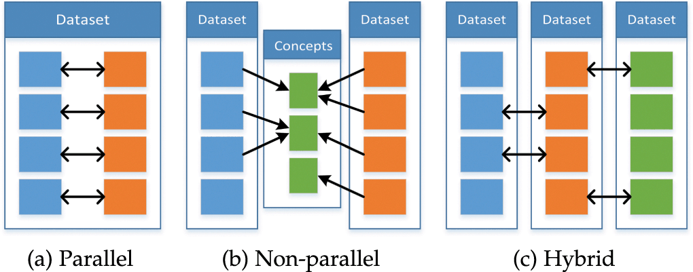
Multimodal co-learning
Transfer learning knowledge between modalities, including their representations and predictive models. Three types: parallel, non-parallel, hybrid.

Slide 21
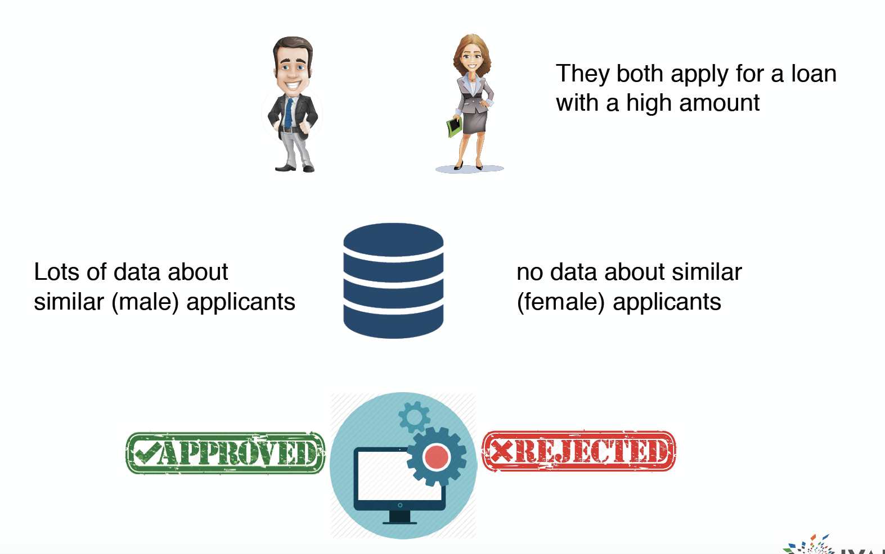
Data bias may result in discrimination (1)
Unbalanced data.
Unfair to users with specific features

Slide 22
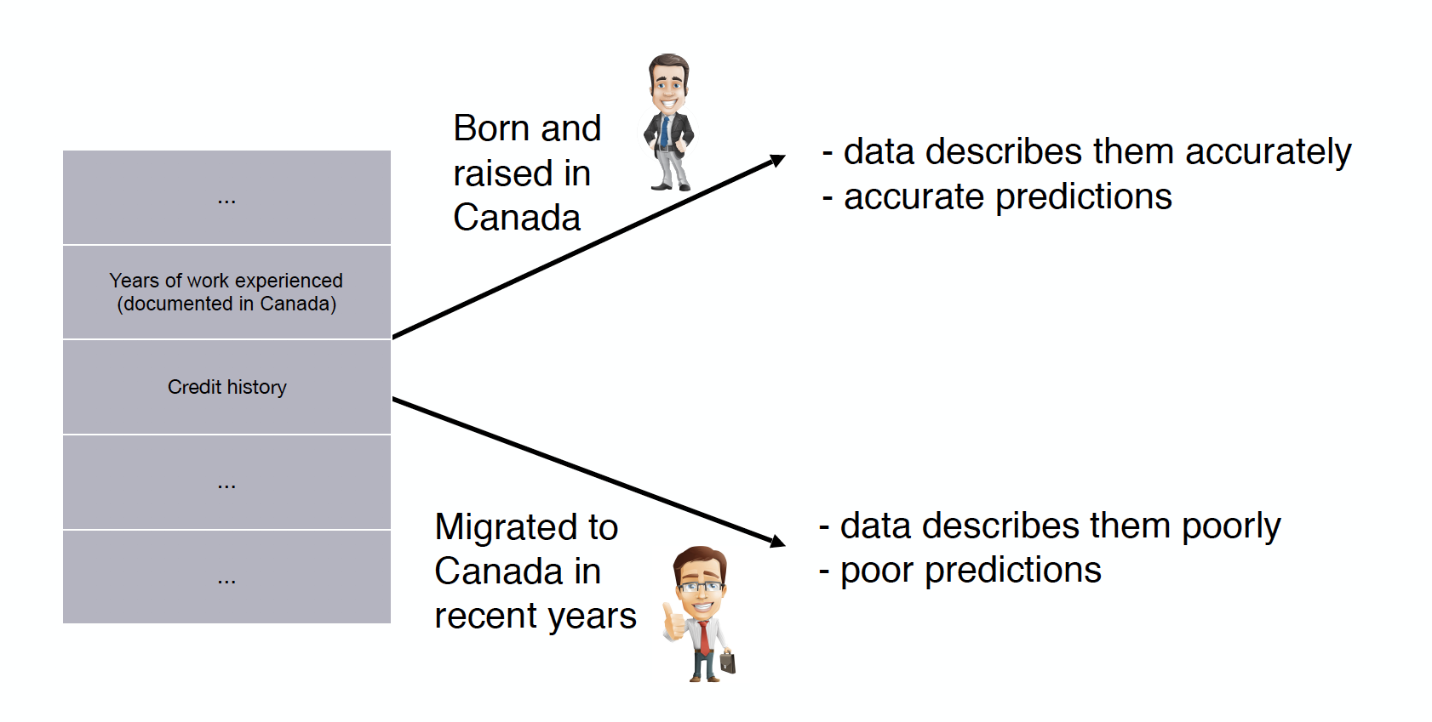
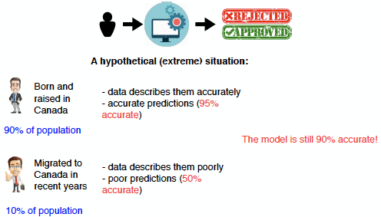
Data bias may result in discrimination (2)
Missing attributes
Overall accuracy is still high, but unfair to a small group of population

Slide 23


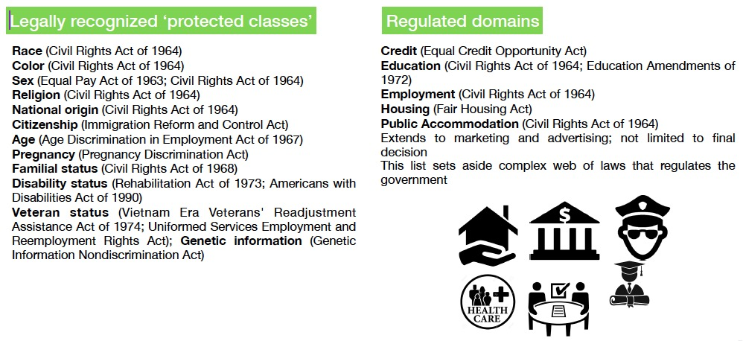
Why we should care about fairness?
Basic social principle!
Law Against Discrimination!
Themis: Greek goddess of justice, divine order, fairness, law, and custom.

Slide 24
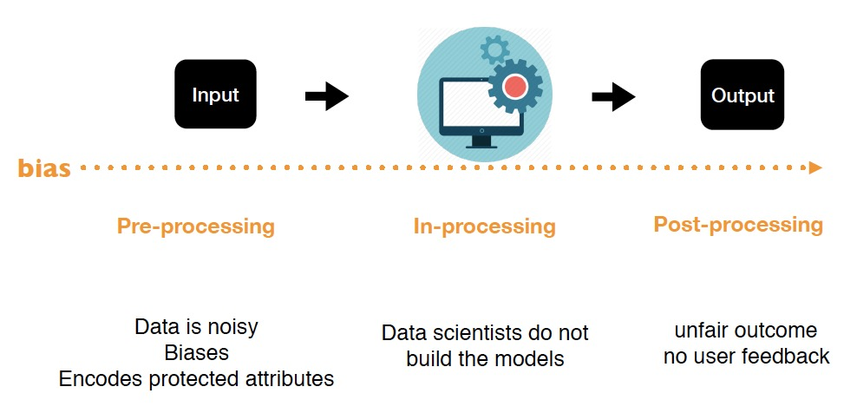
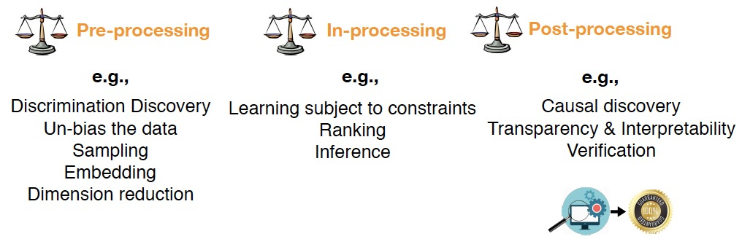
How to address fairness issues in data-related applications?
Bias is across the data engineering pipeline!

Slide 25
Why do we need explainability?
Black-box models achieve the SOTA performance on many data-driven tasks using machine learning, especially deep learning algorithms.
However, it is hard for people to know how the prediction are made and the base of a prediction.
This problem hinders the further application of these models and researchers are required to make models and their predictions more human-understandable.

Slide 26
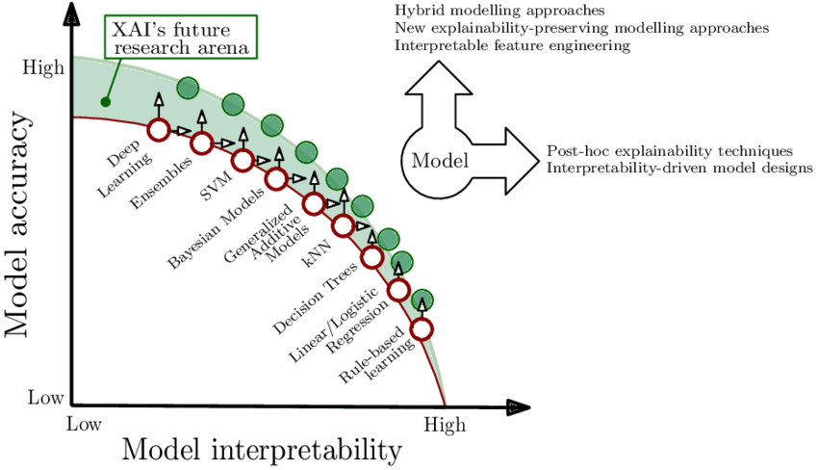
Black-box vs. white-box models
Black-box models (not easily interpretable models): deep learning approaches and the use of representation (embedding) features.
White-box models (easily interpretable models): decision trees, rule-based models, Markov models, logistic regression, linear regression, and so on.
Reduced interpretability comes reduced trust.

Slide 27
Explainability definition
Explainability can be defined as to “understand how a model arrives at its result, also referred to as the outcome explanation problem.” If end-users are able to understand the reasoning behind the prediction, then it is assumed more trust will grow.
Furthermore, this allows for a positive feedback loop from user to development interactions. Some characterizations of explainability include explanations for individual predictions or the model’s prediction process as a whole.

Slide 28
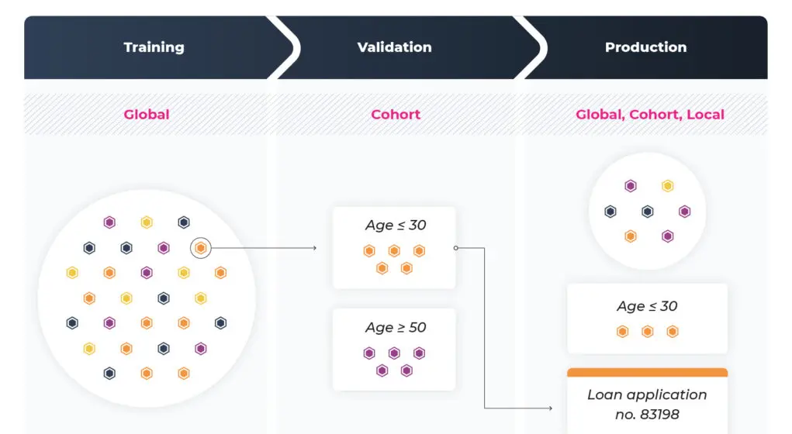
Local explainability vs. global explainability
Local explainability refers to the ability of the system to tell a user why a particular decision was made.
Global explainability is about the explanation of the learning algorithm and model as a whole, including the training data used, appropriate uses of the algorithms, and warnings regarding weaknesses of the algorithm and inappropriate uses. Global explainability is like a “user’s manual”.

Slide 29
Self-explainability vs. post-hoc explainability
Self-explainability (intrinsic explainability) refers to machine learning models that are considered interpretable due to their simple structure, such as short decision trees or sparse linear models. In deep learning, self-explainability refers to using interpretable modules as basic building blocks to replace existing ones.
Post hoc explainability refers to the application of interpretation methods after model training.

Slide 30
Explainability techniques: feature importance
To derive explanation by investigating the importance scores of different features used to output the final prediction.
manual features obtained from feature engineering
latent features learned by NNs
Feature importance metrics
Attention score
First-derivative saliency
Shapley value
Mutual information

Slide 31
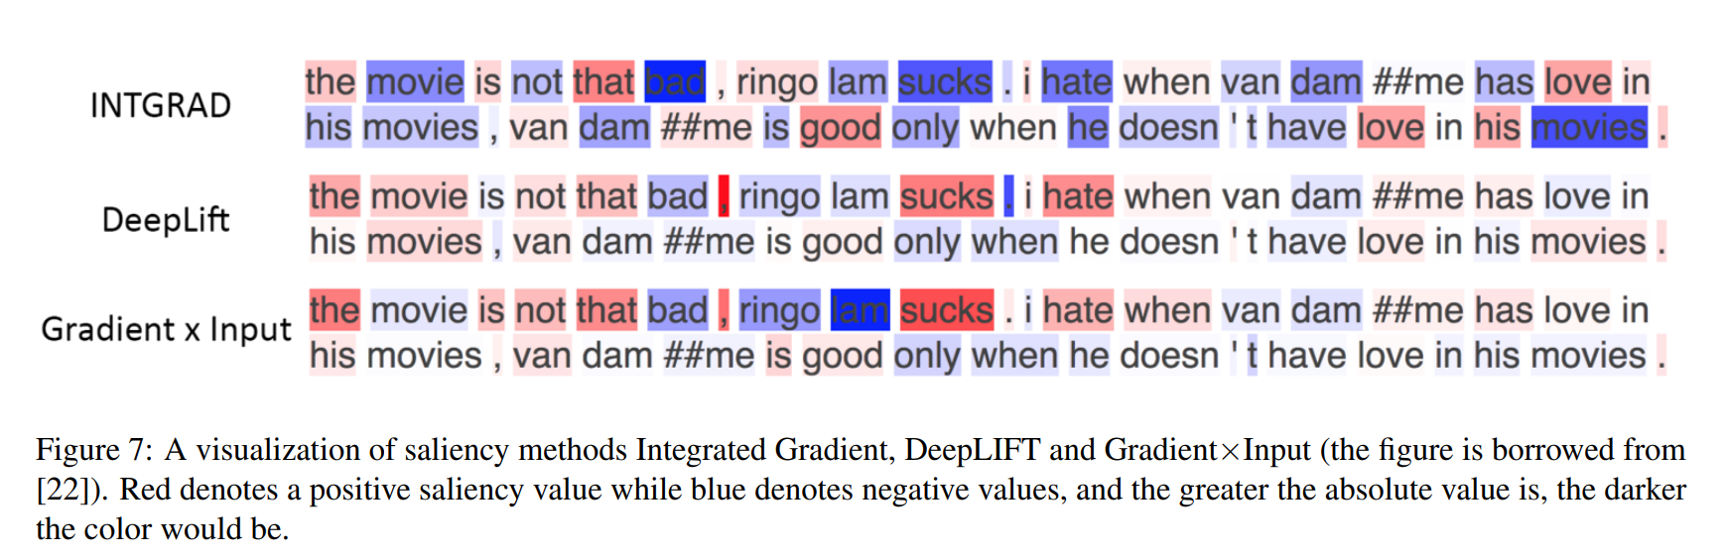
Explanation example
In a sentiment analysis task with different explanation algorithms, the color indicates which words are more important to determine the sentiment of the sentence, to the positive or negative side.

Slide 32
Explainability techniques: surrogate model
Model predictions are explained by learning a second, usually more explainable model, as a proxy.
E.g., LIME, an algorithm that can explain the predictions of any classifier or regressor in a faithful way, by approximating it locally with an interpretable model.
These proxy models are model-agnostic and can achieve both local or global explanations.
One drawback of this method is that the learned surrogate models and the original models may have completely different mechanisms to make predictions, leading to concerns about the fidelity of surrogate model-based approaches.

Slide 33
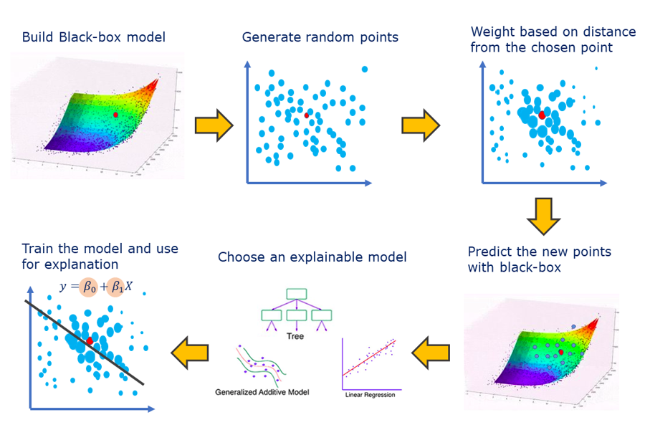
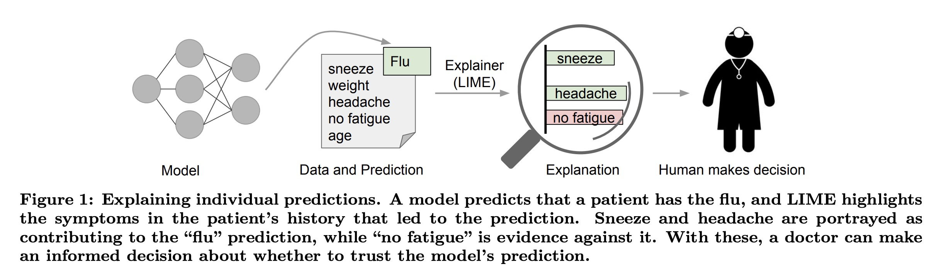
LIME: surrogate model
LIME for Local Interpretable Model-agnostic Explanations

Slide 34
Open problems
What interpretability exactly means and how to define interpretability
How to evaluate interpreting methods
Whose interpretability are we talking about
Go beyond classification tasks
The inconsistency between different interpreting methods
The cost of model performance in exchange for interpretability
The utility of interpretability

Slide 35
Thanks for your attention!

Slide 36
Appendix 1. Multimodal Machine Learning: A Survey and Taxonomy, https://arxiv.org/abs/1705.09406

